Slide 1


Search Algorithms in AI
Lecture 1: Understanding how AI finds solutions to problems"

Slide 2
What is Search?
Search is the process of finding a sequence of actions
Moves an agent from an initial state to a goal state

Slide 3
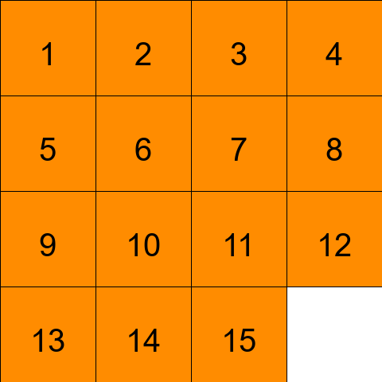
Examples of Search Problems
15 Puzzle (Sliding Tiles)

Slide 4
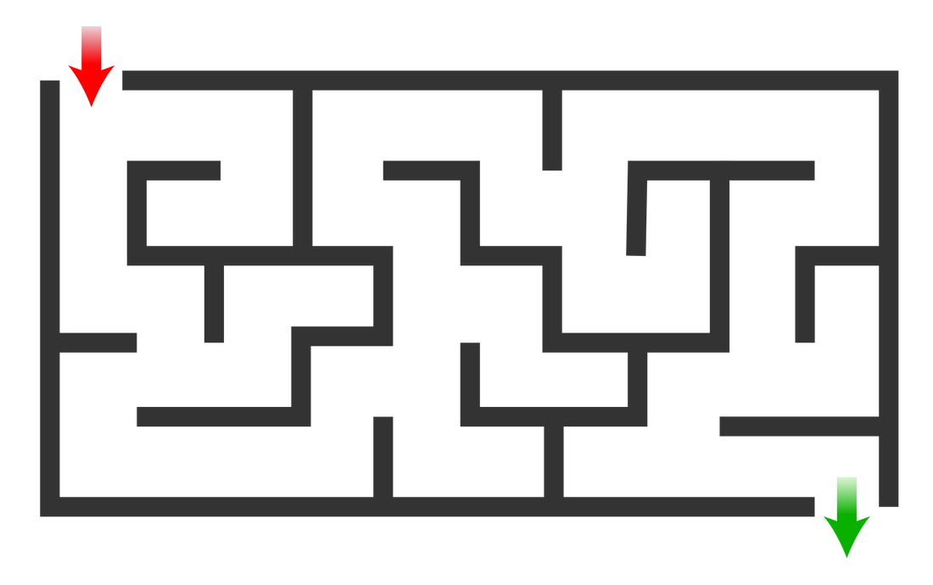
Examples of Search Problems
Maze Navigation

Slide 5

Examples of Search Problems
Determining driving directions (e.g., Google Maps)

Slide 6

Agent and Environment
Agent is an entity that perceive its environment and acts upon that environment.
Examples:
A self-driving car navigating roads
A player (human or AI) solving a puzzle
A navigation system calculating driving directions

Slide 7
Environment
The environment is the setting in which the agent operates.
Examples:
A puzzle board
A maze
A road network for navigation

Slide 8
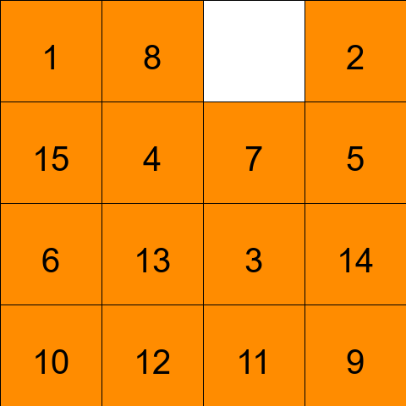
State
A configuration of the agent and environment
Each puzzle arrangement or location is a state

Slide 9
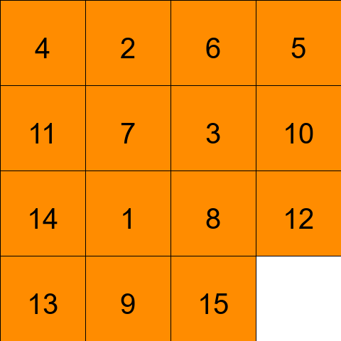
Initial State
The initial state is the starting configuration from which the agent begins solving the problem.
Example:
A scrambled 15-puzzle board
The starting location of a car

Slide 10
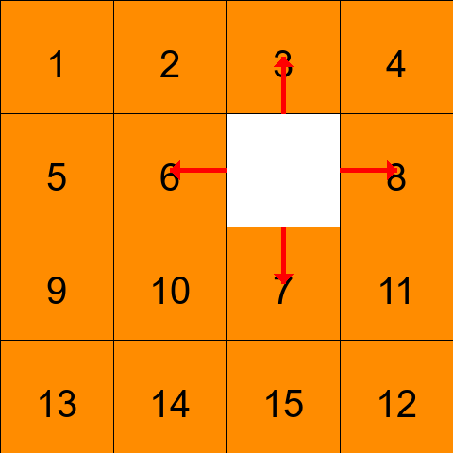
Actions
Actions are the set of possible moves the agent can perform in a given state.
Actions(s) → Returns all possible actions available in state s

Slide 11
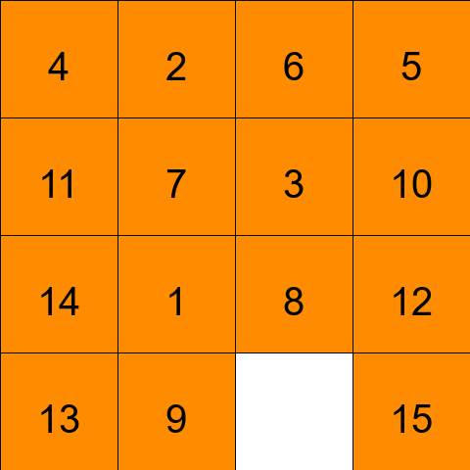
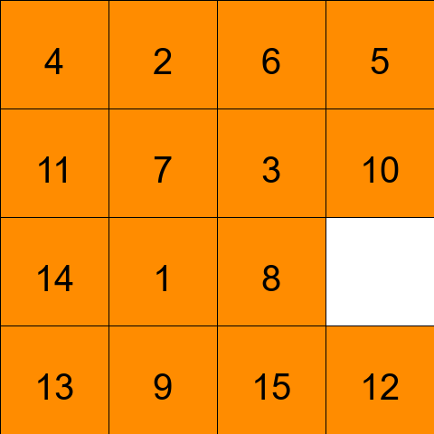
Transition Model
A description of what state results from performing any applicable action in any state.
Result(s, a) → New State"

Slide 12
State Space
The set of all states reachable from the initial state by any sequence of actions.

Slide 13
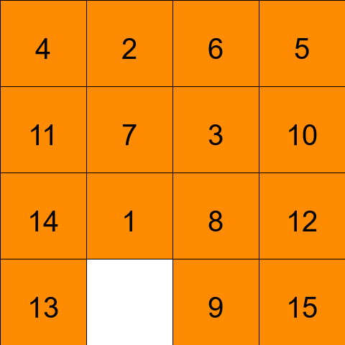
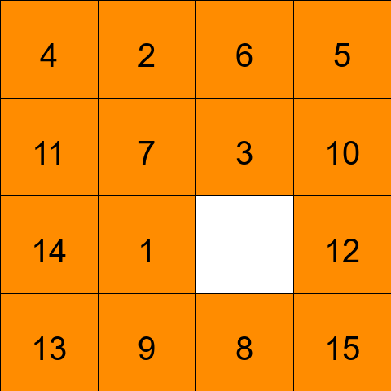
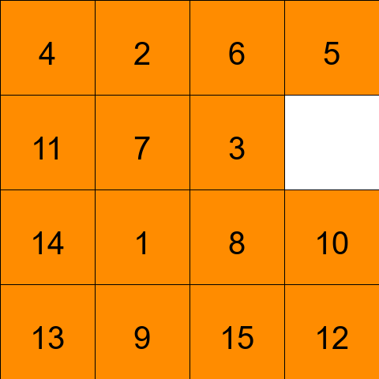
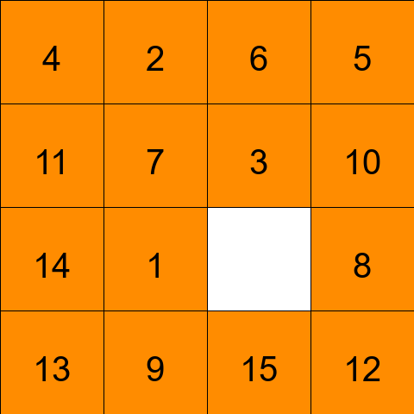
State Space

Slide 14
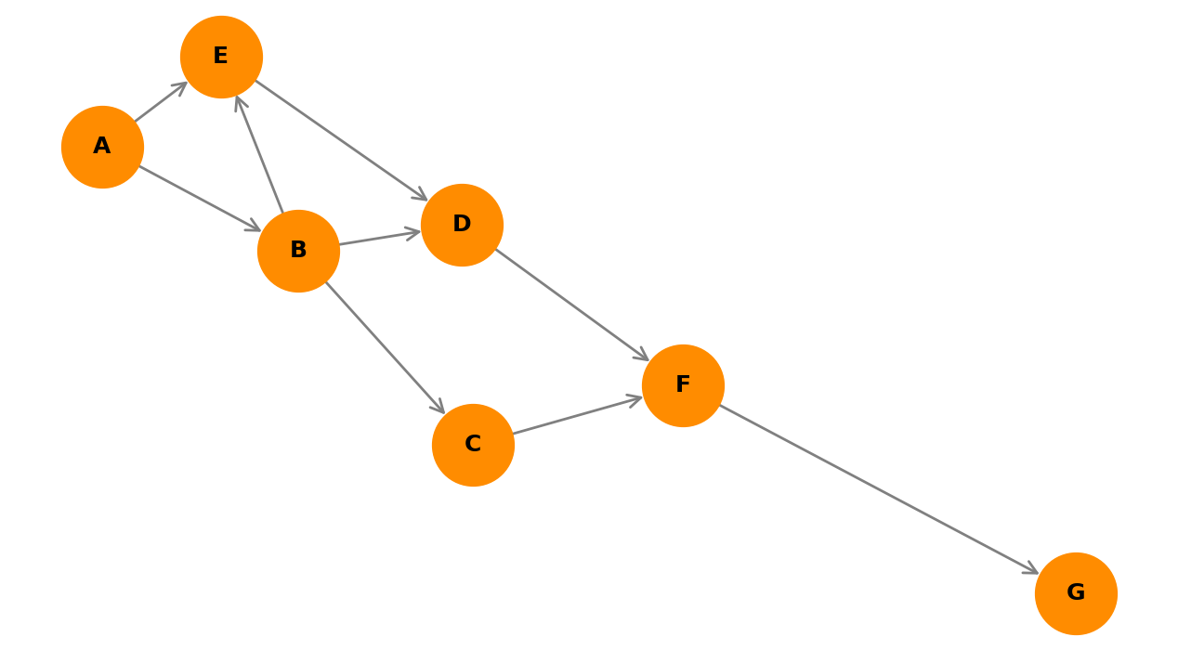
State Space
This can be represented as a Graph

Slide 15
Goal State
Desired final state
Example: Solved puzzle or destination reached
Goal Test: way to determine whether a given state is a goal state.

Slide 16
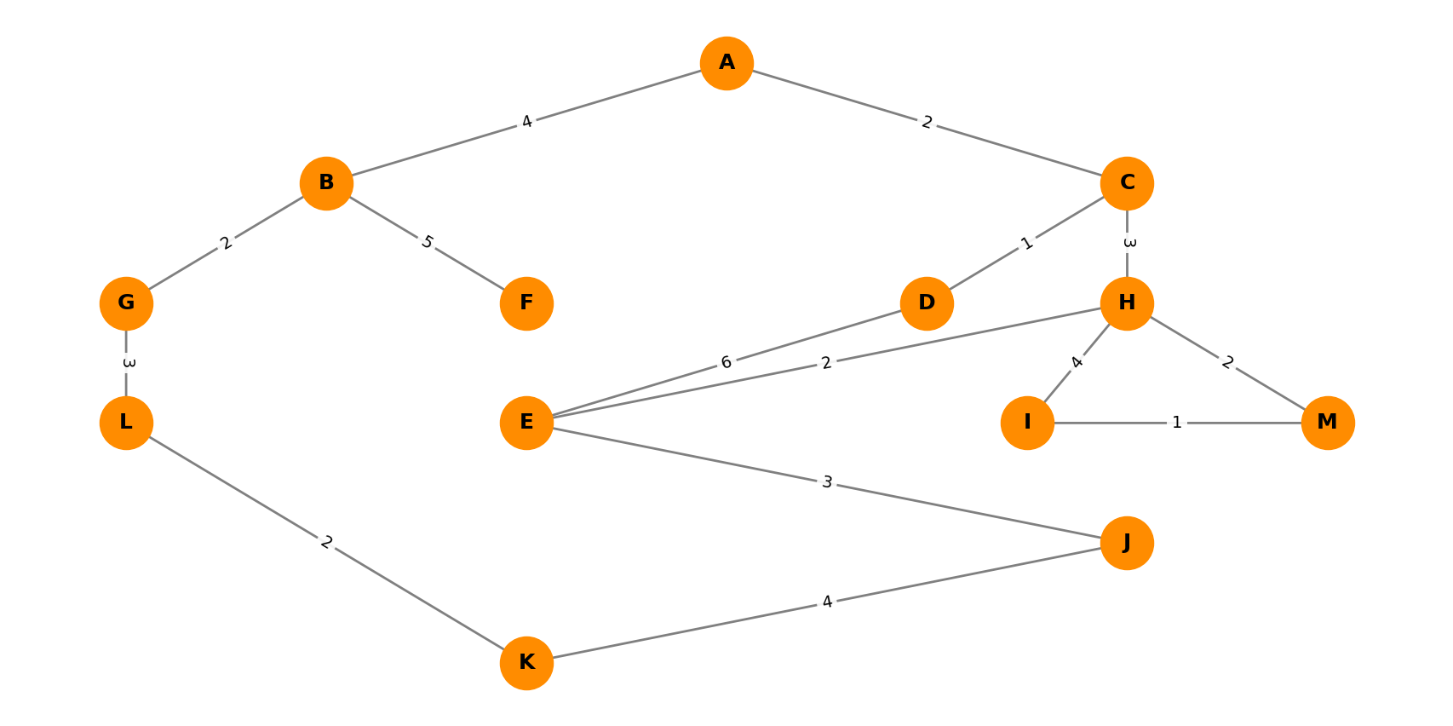
Path Cost
Path cost: numerical cost associated with a given path.
The path can be of equal cost in some problems

Slide 17
These form the based of all search problems:
initial state
action
transition model
goal test
path cost function
solution: sequence of actions that leads from the initial state to a goal state
optimal solution: a solution that has the lowest path cost among all solution.

Slide 18
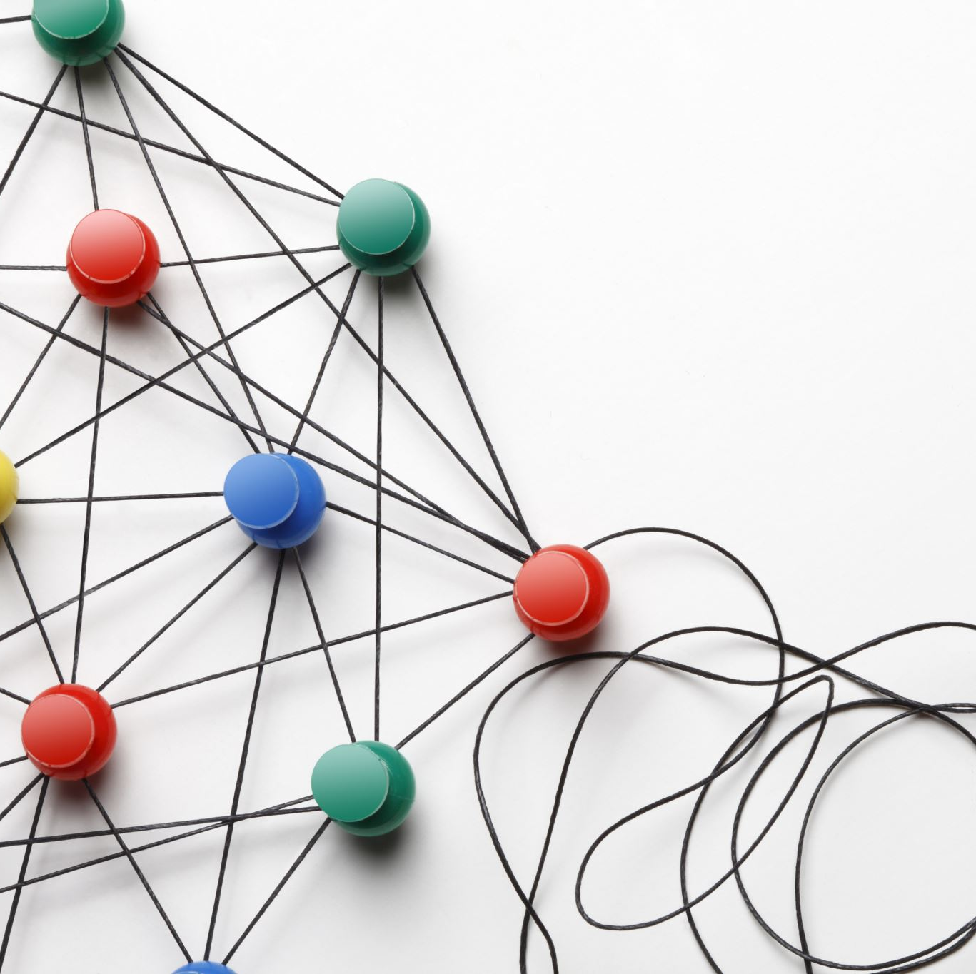
How to Solve these Problem?
Node: a data structure that keeps track of
a state
a parent
an action
a path cost

